Slide 1




Analyzing Complaint Trends Across Financial Industries
Presented by Information Analyst:
Hoor Alsayoof
DAB-3
Technology Innovation

Slide 2
Introducing the CFPB
01
Who are we?
The or The Consumer Financial Protection Bureau is a U.S. government agency dedicated to protecting and standing for consumers founded in 2011.
The primary mission of the CFPB is to protect consumers in the financial marketplace by enforcing consumer protection laws and regulating financial institutions.

Slide 3

Purpose and Problem Statement
02
In recent years, there has been a noticeable increase in the quarterly volume of complaints received by the Consumer Financial Protection Bureau (CFPB).
What is the reason behind those complaints being increased🤔?

Slide 4




the process of complaints submission
03
1. Complaint Submission
4. Follow-Up and Feedback
3. Companies typically respond within 15 days
2. CFPB will send the complaint to the company

Slide 5
04
Analysis and Investigation
Data on complaints for 11 years 2012–2023

Slide 6
The relation of days and sending the complaint to companies is unrelated
After consumers send their complaints
99% of complaints were giving a timely response from the companies.
The sending period can possibly take up to nineteen days.
However, 86% of complaints were being sent to the companies within 2 days receival.

Slide 7

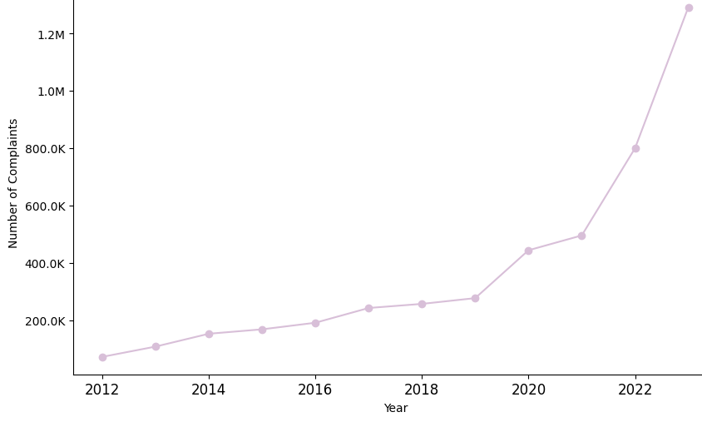

The volume of complaints increased sharply since 2019
On of the reasons the volume of complaints increased after 2019 is due to some companies failing to respond to consumer complaints during the pandemic.

Slide 8
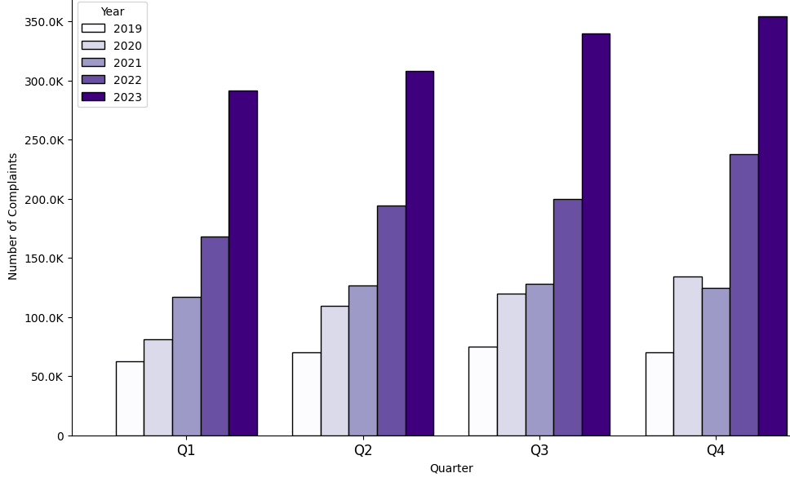
The volume of complaints is increasing in each quarter since 2019

Slide 9
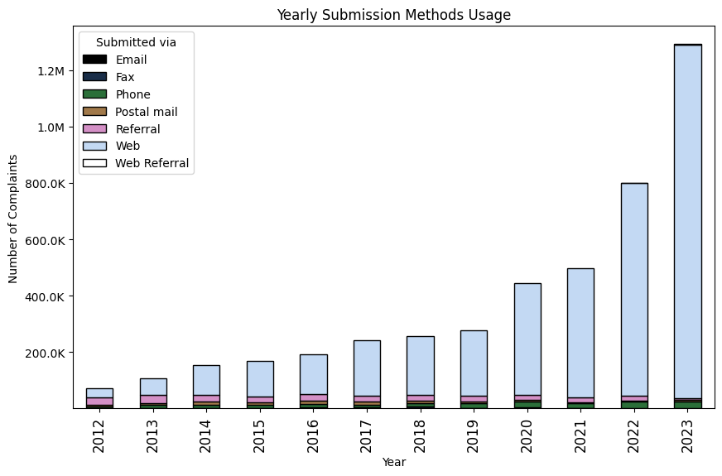
The most used submission method goes for the web

Slide 10
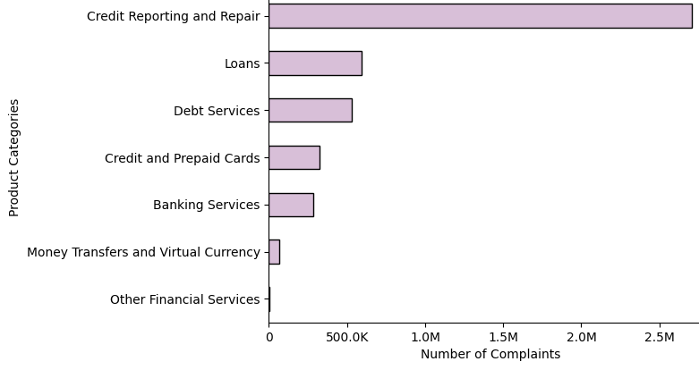
Credit reporting holds most of the complaints based on the product categories

Slide 11
The top 3 most reported issues belong to the credit report and repair category
1,232,421 complaints
629,976 complaints
589,336 complaints
Problem with a credit reporting company's investigation into an existing problem
Incorrect information on your report
Improper use of your report
Following:
4. Attempts to collect debt not owed: 192,756
5. Managing an account: 120,192
6. Loan modification, collection, foreclosure: 111,662
7. Incorrect information on credit report: 102,684

Slide 12
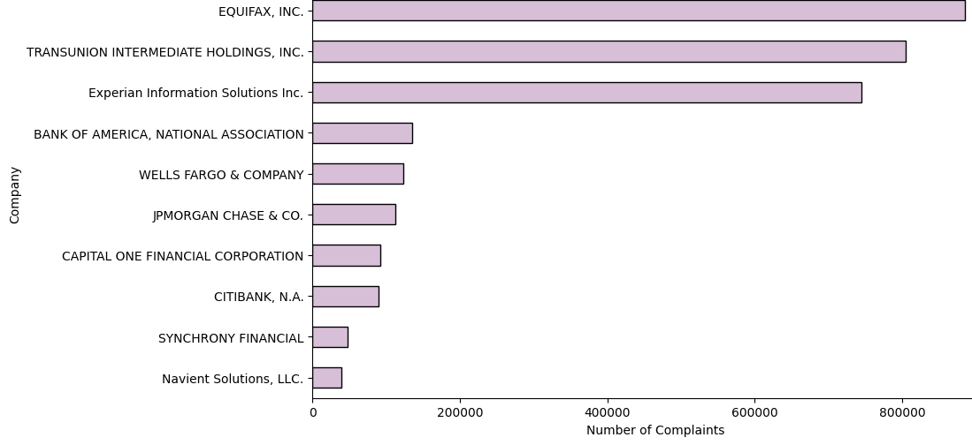
Top 3 companies are all providing credit reporting services
CNBC stated that the credit raters potentially violated the Fair Credit Reporting Act. FTC* mentioned the failure of companies accurate reports.
*Federal Trade Commission

Slide 13
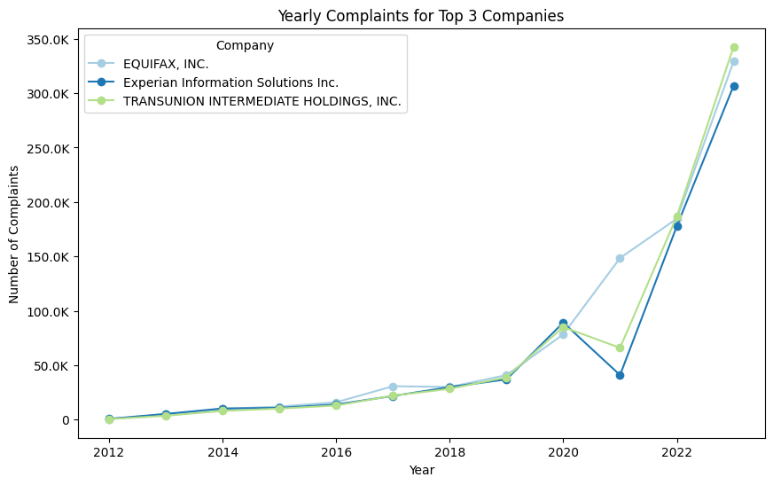
Historical records show that 2021 had the most issues resolved, followed by a rise in complaints.

Slide 14
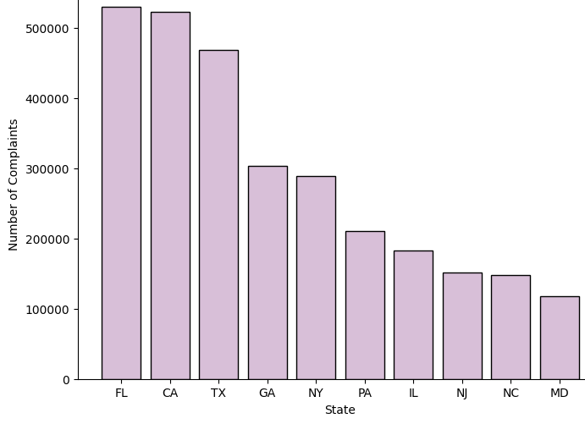
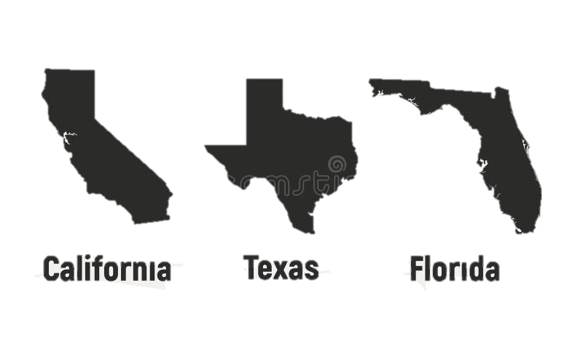
Florida, California, and Texas hold most of the complaints

Slide 15
Most companies prefer to close complaints with an explanation and do not prefer public responses
Company response to consumers:
73%
24%
3%
Closed with an explanation
Closed with a nonmonetary relief
Closed with a monetary relief
Company public response:
91%
6%
Remaining
Publicly responded to the consumer and the CFPB and chooses not to provide a public response
Believes that they acted appropriately as authorized by contract or law
Choose not to provide a public response

Slide 16
Conclusion – Recommendation
05
The CFPB is sending majority of complaints to companies within timeline of 3 days.
Complaints in the financial sector will keep increasing by the years.
States with more population cover most of the complaints.
Most companies tend to provide an explanation to the consumer that meet their desired resolution or explains why no further action will be taken.
Companies providing credit reporting services are advised to keep a regular check up on their customer's feedback.
Scandals and company reputation affect the volume of complaints.

Slide 17


Thank you for your time!
Do you have any questions😗🤫?

Slide 18
Table of contents
01
02
Purpose and Problem Statement
Introducing the CFPB
05
03
04
Analysis and Investigation
Conclusion

Slide 19
Introducing the CFPB
01
1. Complaint Submission
2. CFPB will send the complaint to the company
3. Companies typically respond within 15 days
Process
4. Follow-Up and Feedback

Slide 20
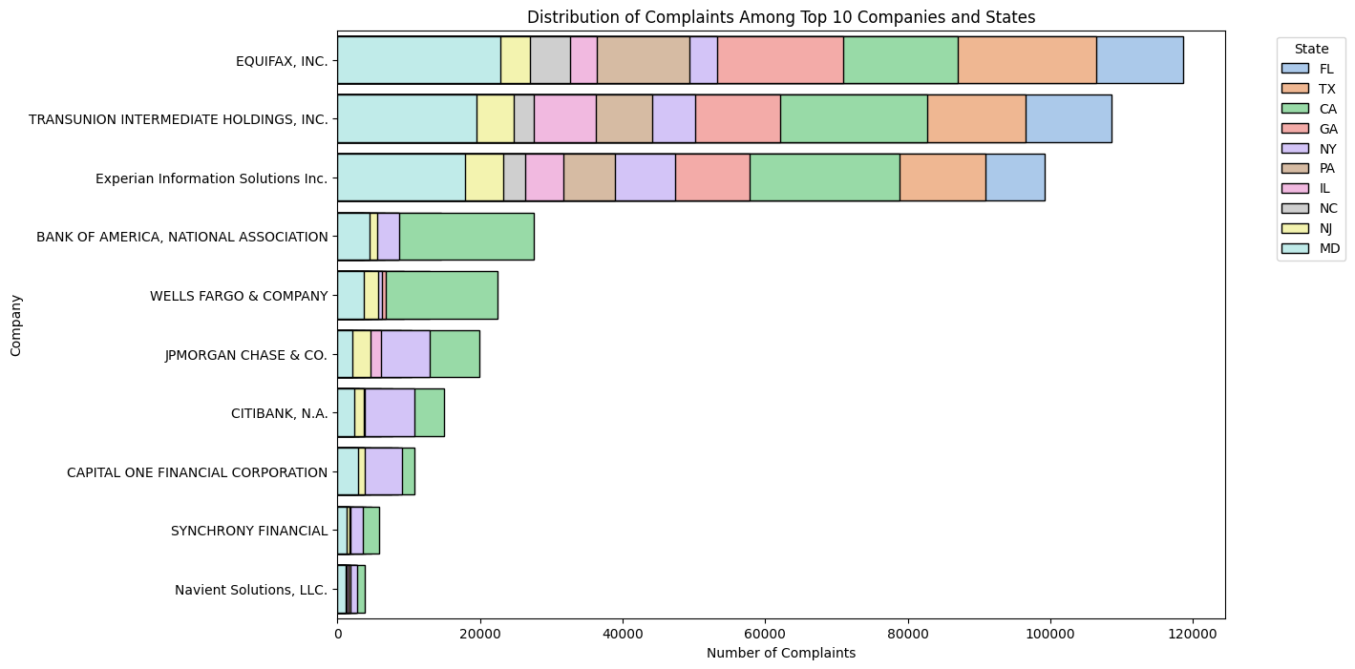

challenges related to credit reporting agencies mostly in California, Texas, Florida, and Maryland

Slide 21
Most common issues reported
 | Issue | Count
1 | Incorrect information on your report | 1,232,421
2 | Improper use of your report | 629,976
3 | Problem with a credit reporting company's investigation into an existing problem | 589,336
4 | Attempts to collect debt not owed | 192,756
5 | Managing an account | 120,192
6 | Loan modification, collection, foreclosure | 111,662
7 | Incorrect information on credit report | 102,684
8 | Problem with a company's investigation into an existing problem | 89,633
9 | Written notification about debt | 83,564
10 | Trouble during payment process | 77,161

Slide 22
The type of complaints for top 10 companies with most complaints
Product Category/ Company | Banking Services | Credit Reporting and Repair | Credit and Prepaid Cards | Debt Services | Loans | Money Transfers and Virtual Currency | Other Financial Services
EQUIFAX, INC. | 62 | 871951 | 3631 | 9523 | 601 | 34 | 3
TRANSUNION INTERMEDIATE HOLDINGS, INC. | 67 | 790824 | 3920 | 9622 | 588 | 40 | 1
Experian Information Solutions Inc. | 98 | 730451 | 3613 | 9624 | 651 | 59 | 7
BANK OF AMERICA, NATIONAL ASSOCIATION | 41858 | 8845 | 27161 | 4584 | 48527 | 4235 | 73
WELLS FARGO & COMPANY | 39674 | 8780 | 11611 | 4506 | 54878 | 4144 | 57

Slide 23

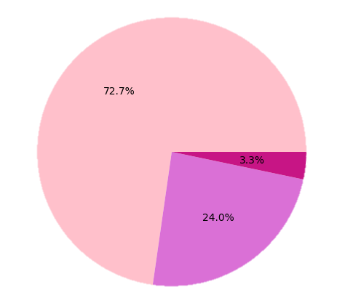
Common company response to consumer and public response
Company response to consumers:
around 73% of complaints are closed with an explanation, 24% closed with a nonmonetary relief, and 3% closed with a monetary relief.
Company public response:
almost 91% of companies publicly responded to the consumer and the CFPB and chooses not to provide a public response, 6% of companies believes that they acted appropriately as authorized by contract or law. However, some companies choose not to provide a public response.

Slide 24

Most companies prefer to close complaints with an explanation and do not prefer public responses
Company response to consumers:
Around 73% of complaints are closed with an explanation, 24% closed with a nonmonetary relief, and 3% closed with a monetary relief.
Company public response:
Almost 91% of companies publicly responded to the consumer and the CFPB and chooses not to provide a public response, 6% of companies believes that they acted appropriately as authorized by contract or law. However, some companies choose not to provide a public response.
DID YOU KNOW THAT:
Most companies that are providing credit reporting services are having scandals, and one of the reasons why the volume of complaints increased after 2019 is due to some of those companies failing to respond to consumer complaints during the pandemic.

Slide 25
Florida, California, and Texas hold most of the complaints
More than 530,000 complaints
Around than 520,000 complaints
Around than 470,000 complaints

Slide 26

DID YOU KNOW THAT🤨:
Most companies that are providing credit reporting services are having scandals, and one of the reasons why the volume of complaints increased after 2019 is due to some of those companies failing to respond to consumer complaints during the pandemic.

